Slide 2

Agenda
Google Drive functions and database design as follow
Resolve Permission in Google Drive
Fulltext Search with BM25
Q&A

Slide 3
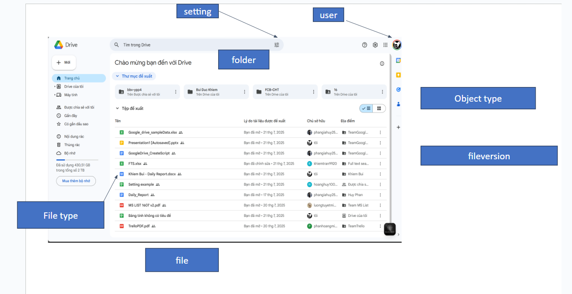
First Screen
Recent

Slide 4
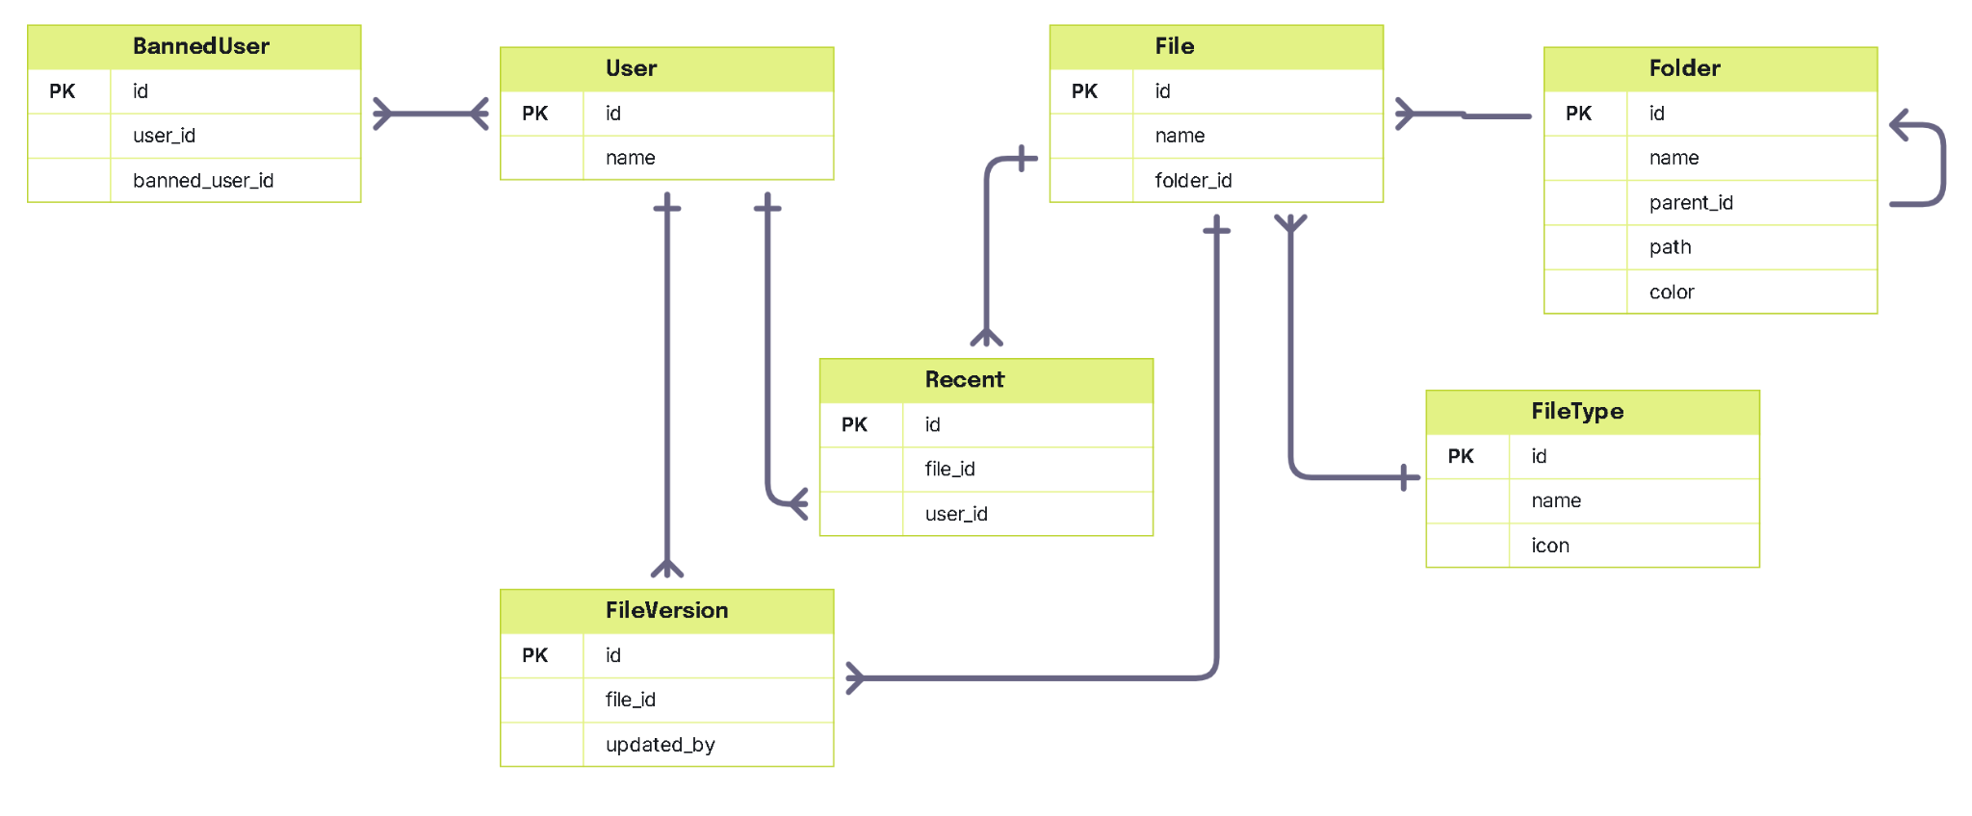
Database Structure For First Screen

Slide 5
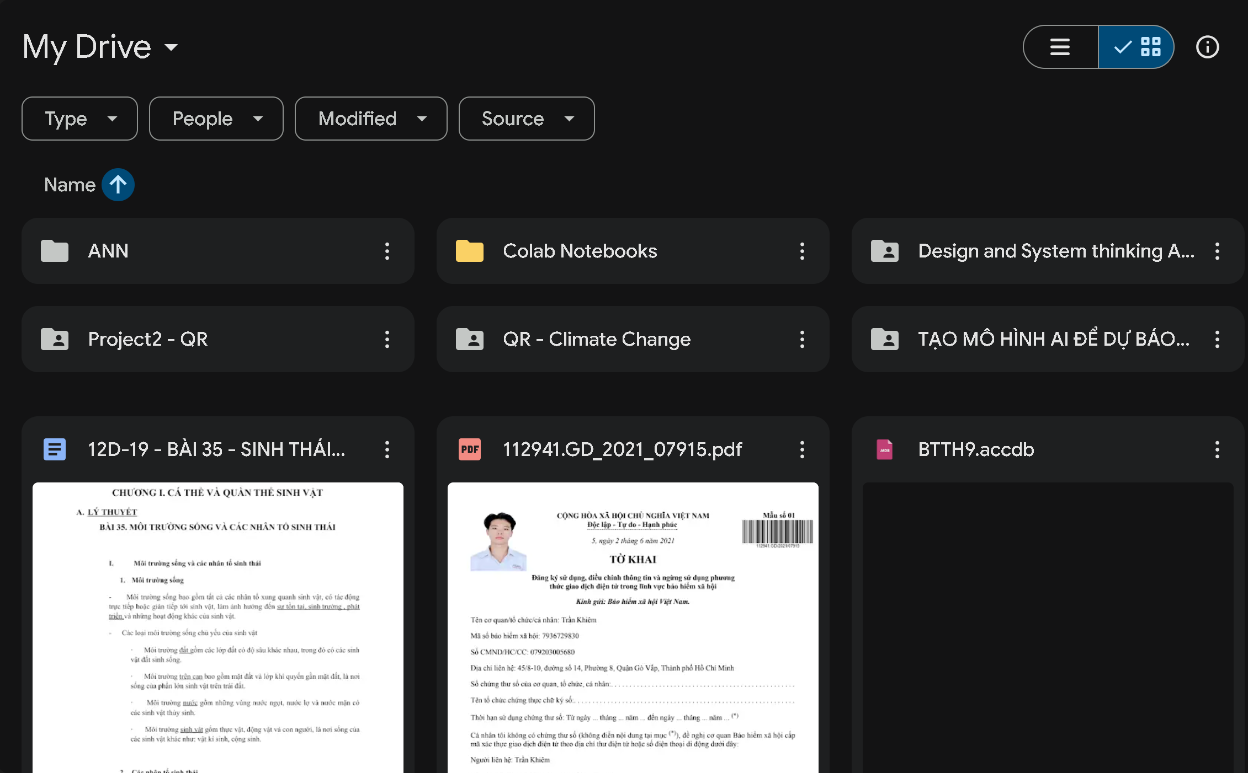
Get folder
Get file
Notes:
--get folders of an user
select
f.id,
f.Name as FolderName,
f.Path as FolderPath,
f.UpdatedAt as FolderUpdateTime,
f.Size
from Folder f
join Users u on f.OwnerId = u.Id
where u.id = 1
and f.Status = 'active'
order by f.UpdatedAt DESC;
--get files of an user
select
f.id,
f.Name as [FileName],
f.Path as FilePath,
f.ModifiedDate as FileUpdateTime,
ft.Name as FileType,
f.Size
from Files f
join Users u on f.OwnerId = u.Id
join FileType ft on f.FileTypeId = ft.Id
where u.id = 1
and f.Status = 'active'
order by f.ModifiedDate;

Slide 6
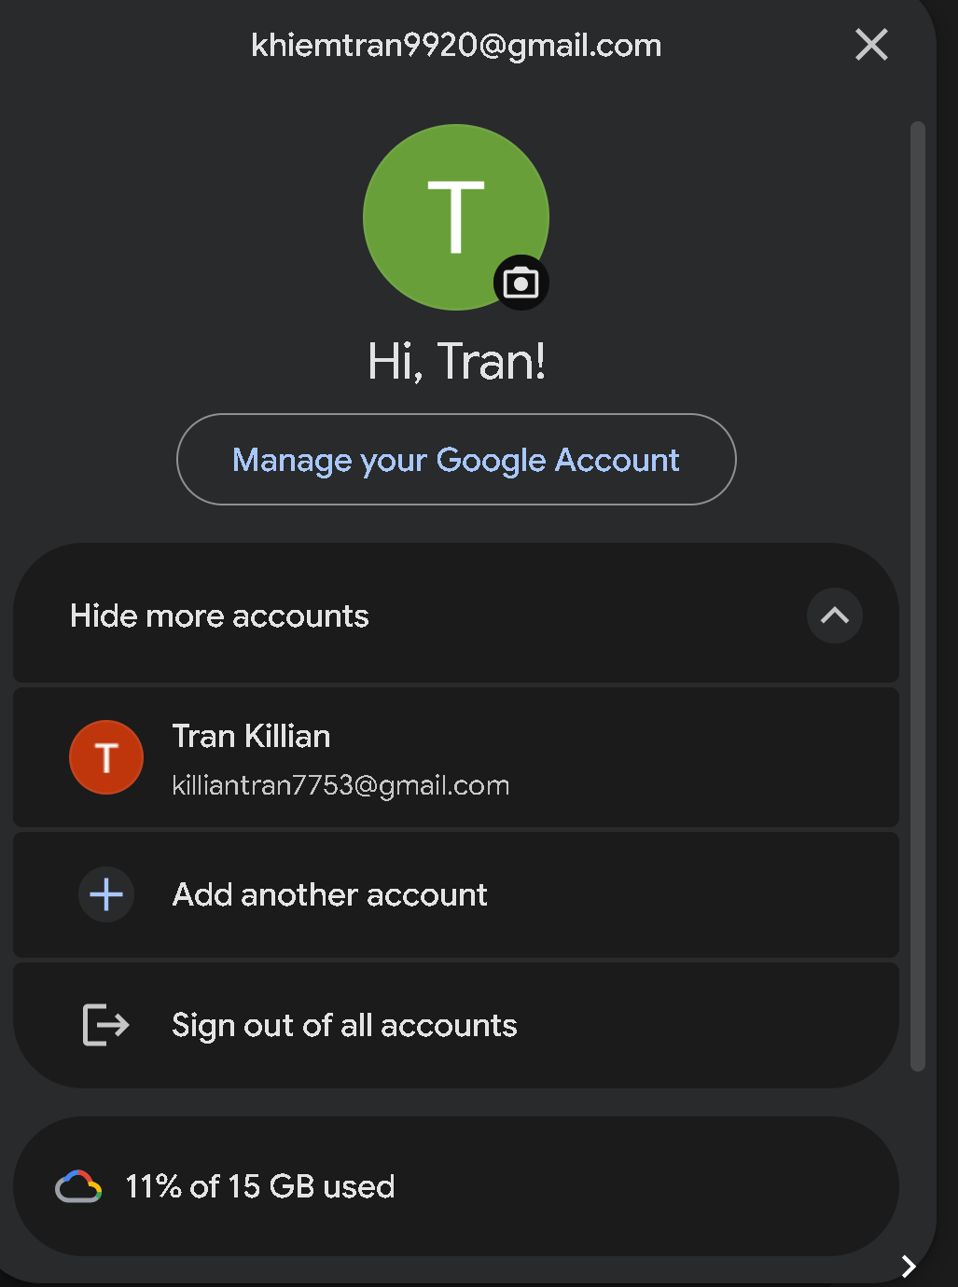
Get user information
select
u.id,
u.Name as UserName,
u.Email as UserEmail,
u.LastLogin as UserLastLogin
from Users u
where u.id = 1;
Notes:
select
u.id,
u.Name as UserName,
u.Email as UserEmail,
u.LastLogin as UserLastLogin
from Users u
where u.id = 1;

Slide 7
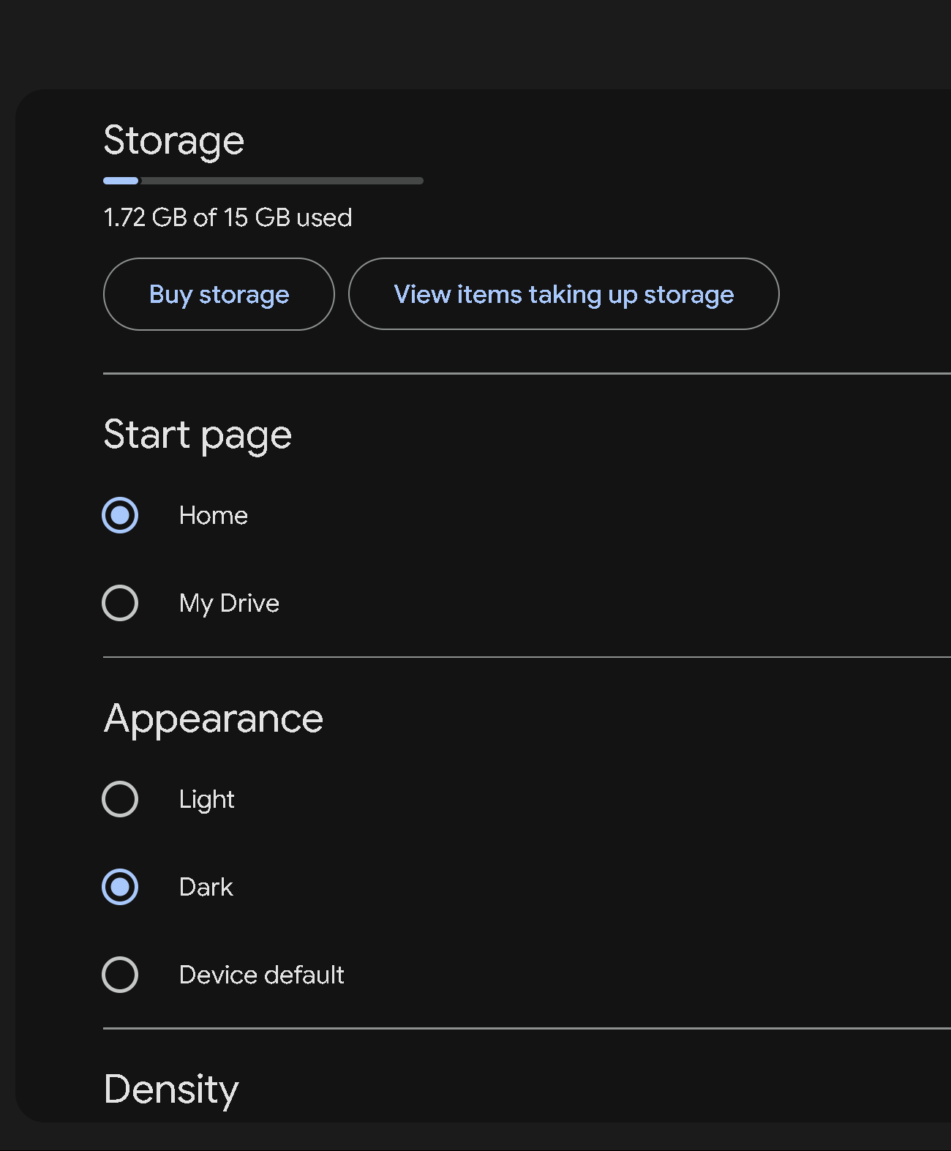
Get user setting
select
u.Name as UserName,
s.SettingKey,
s.SettingValue
from SettingUser su
join Users u on su.UserId = u.Id
join Setting s on su.SettingId = s.Id
where u.Id =1
SettingKey
SettingValue
Notes:
select
u.Name as UserName,
s.SettingKey,
s.SettingValue
from SettingUser su
join Users u on su.UserId = u.Id
join Setting s on su.SettingId = s.Id
where u.Id =1

Slide 8
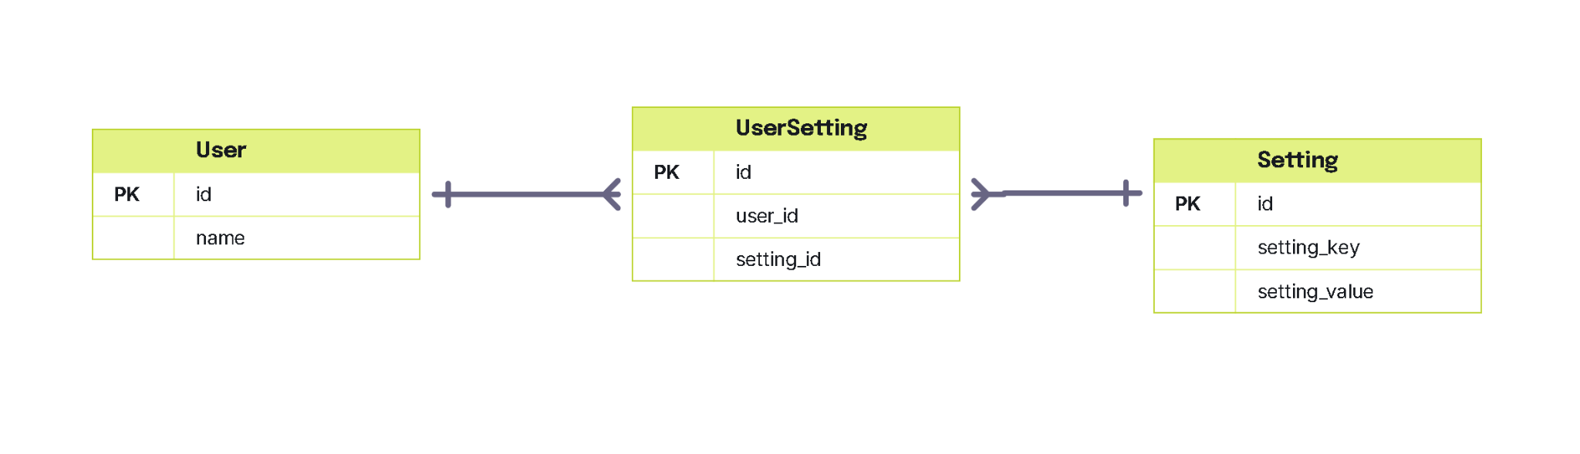
Table For Setting Feature

Slide 9
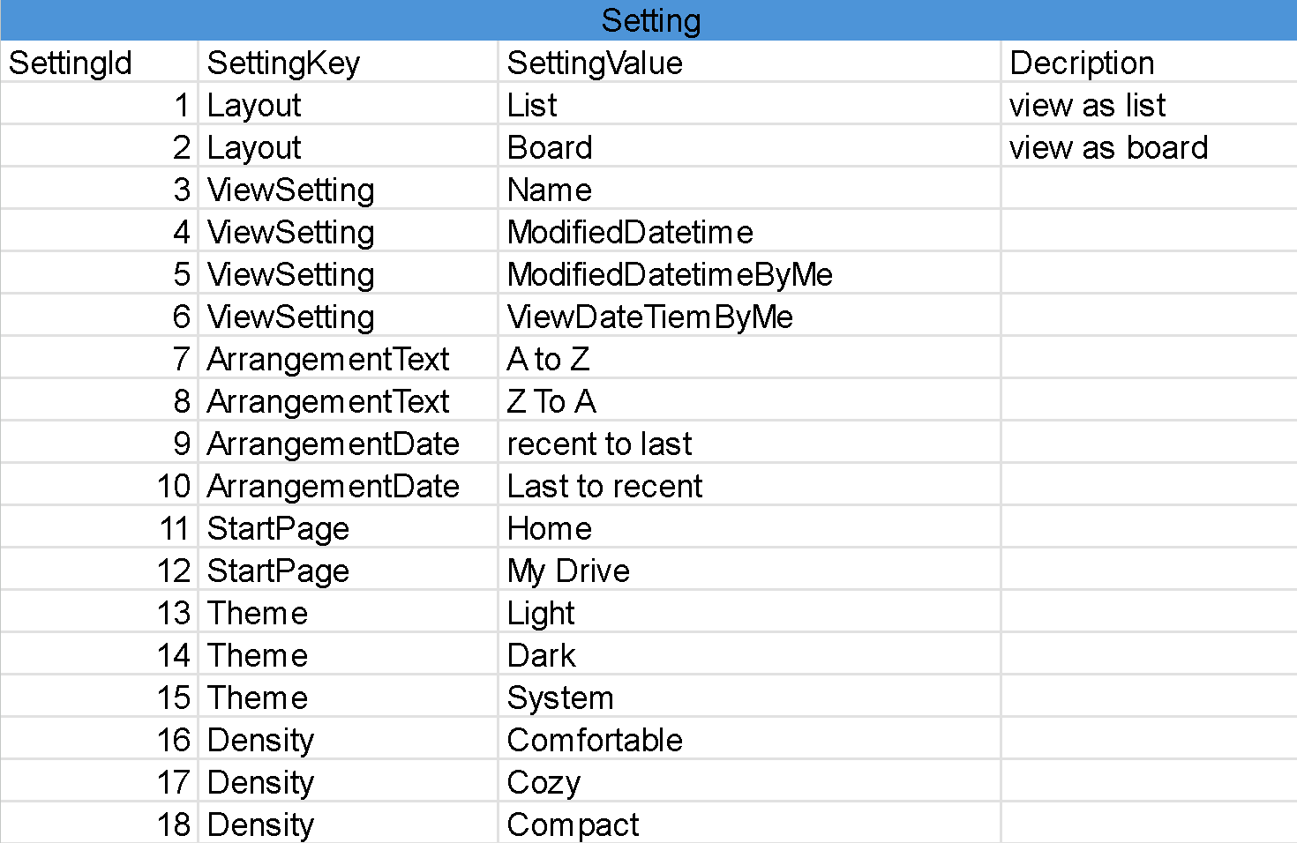
Setting Sample Data

Slide 10
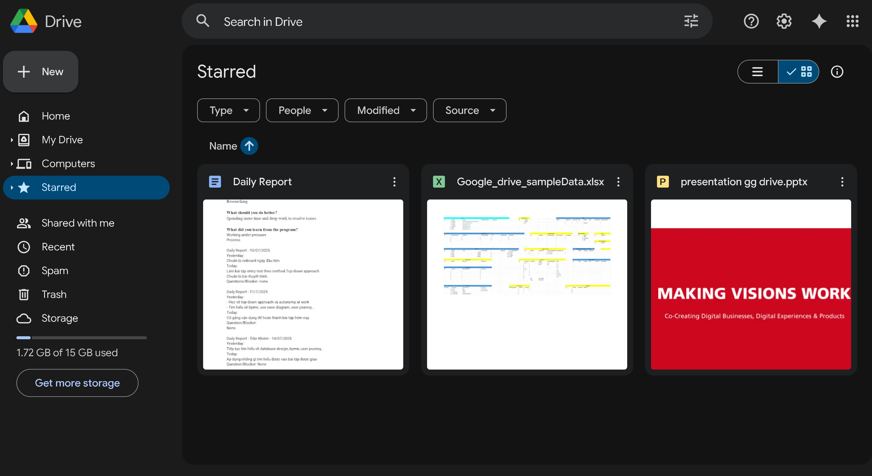
Get starred objects
Notes:
select
fo.id,
fo.ObjectId,
fo.ObjectTypeId,
ot.Name as ObjectType,
case
when fo.ObjectTypeId = 1 then f.Name
else fi.Name
end as [Name]
from FavoriteObject fo
join Users u on fo.OwnerId = u.Id
join ObjectType ot on fo.ObjectTypeId = ot.Id
left join Folder f on fo.ObjectId = f.Id AND fo.ObjectTypeId = 1
left join Files fi on fo.ObjectId = fi.Id AND fo.ObjectTypeId = 2
where fo.OwnerId = 1
order by ot.Name;

Slide 11
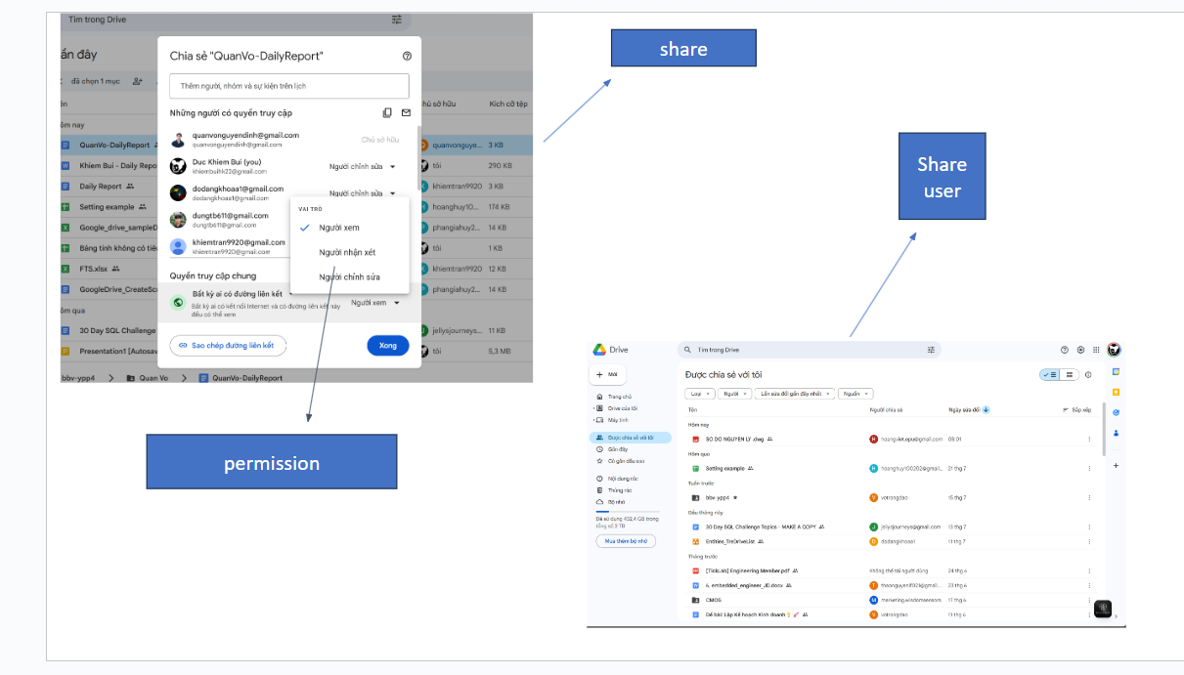
Share

Slide 12
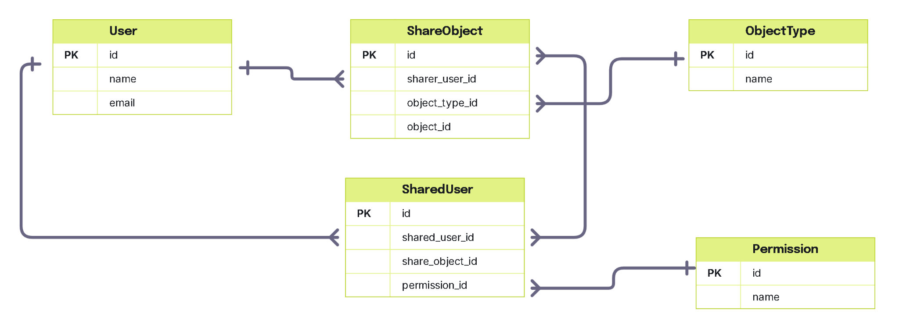
Table for Share feature

Slide 13
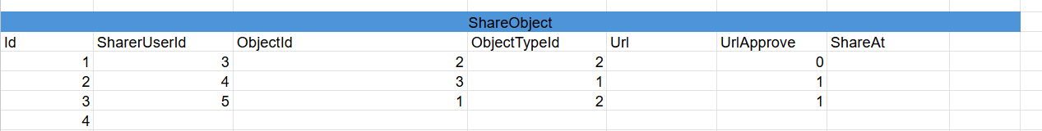
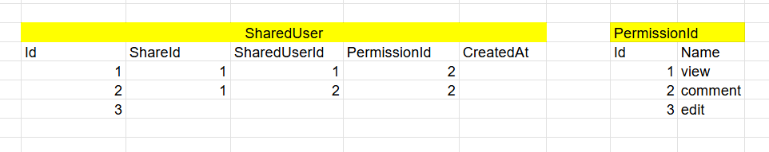
Sample data for share feature

Slide 14
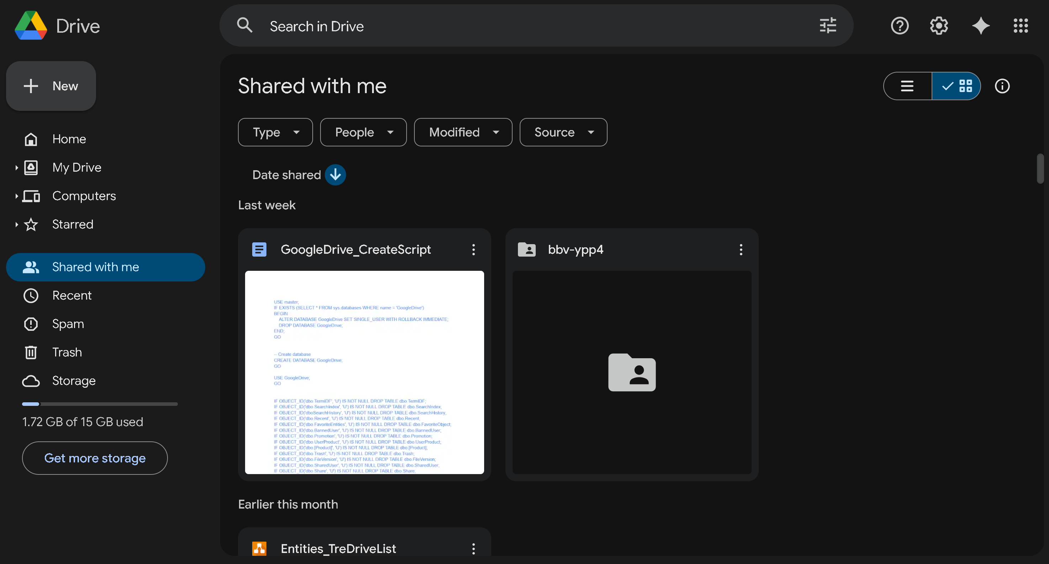
Get shared objetcs with an user
Notes:
--get shared objects with an user
select
s.ObjectId,
s.ObjectTypeId,
ot.Name as ObjectType,
case
when s.ObjectTypeId = 1 then f.Name
else fi.Name
end as [Name],
p.Name as Permission,
u2.Name as SharerName,
s.CreatedAt as ShareCreated,
s.ExpiresAt as ShareExpires
from SharedUser su
join Share s on su.ShareId = s.Id
join Users u on su.Id = u.Id
join Users u2 on s.Sharer = u2.Id
join ObjectType ot on s.ObjectTypeId = ot.Id
join Permission p on su.PermissionId = p.Id
left join Folder f on s.ObjectId = f.Id and s.ObjectTypeId = 1
left join Files fi on s.ObjectId = fi.Id and s.ObjectTypeId = 2
where su.UserId = 1
and s.ExpiresAt > GETDATE()
order by s.CreatedAt DESC;

Slide 15
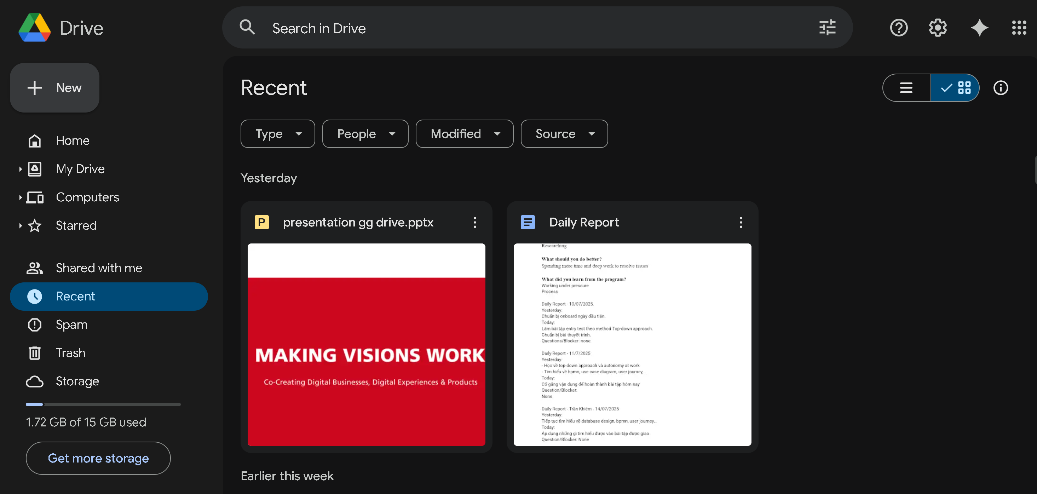
Get recent objects of an user
Notes:
select
r.Id,
case
when r.ObjectTypeId = 1 then f.Name
else fi.Name
end as [Name],
case
when r.ObjectTypeId = 1 then f.Path
else fi.Path
end as [Name],
ft.Name as FileType,
r.DateTime as LastAccessed
from Recent r
join Users u on r.Id = u.Id
left join Folder f on f.Id = r.ObjectId and r.ObjectTypeId = 1
left join Files fi on fi.Id = r.ObjectId and r.ObjectTypeId =2
join FileType ft on fi.FileTypeId = ft.Id
where r.UserId = 1
order by r.DateTime DESC;

Slide 16
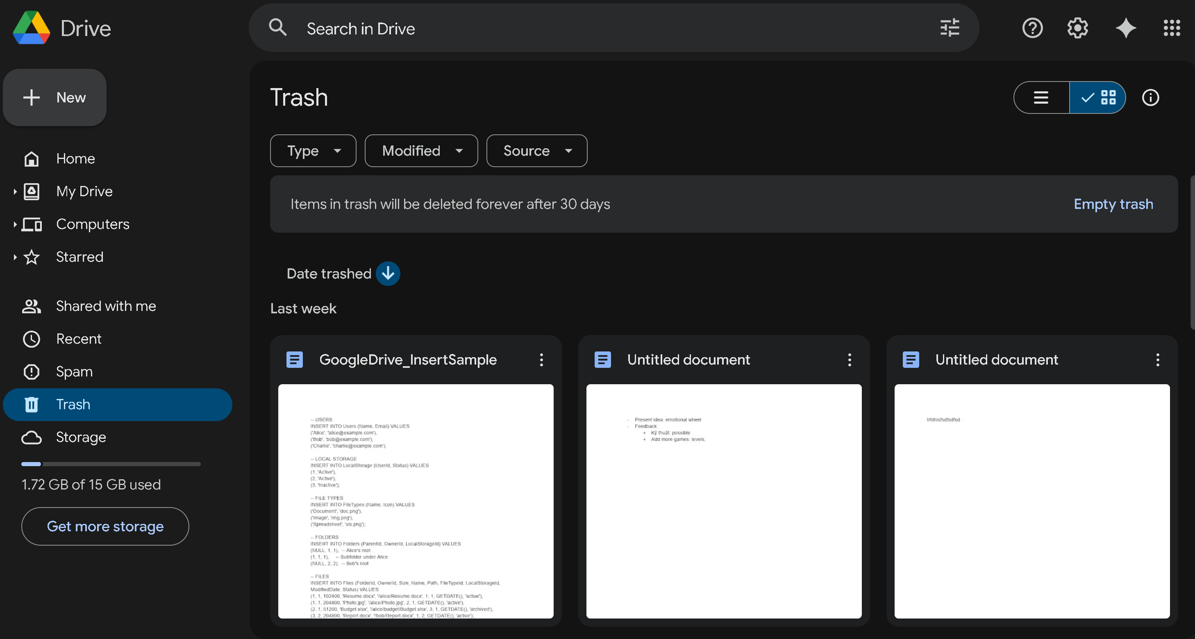
Get trash objects of an user
Notes:
select
t.id,
t.ObjectId,
t.ObjectTypeId,
t.RemovedDatetime,
case
when t.ObjectTypeId = 1 then f.Name
else fi.Name
end as [Name]
from Trash t
join Users u on t.UserId = u.Id
join ObjectType ot on t.ObjectTypeId = ot.id
left join Folder f on t.ObjectId = f.Id and t.ObjectTypeId = 1
left join Files fi on t.ObjectId = fi.Id and t.ObjectTypeId =2
where t.UserId = 1
order by t.RemovedDateTime DESC;

Slide 17
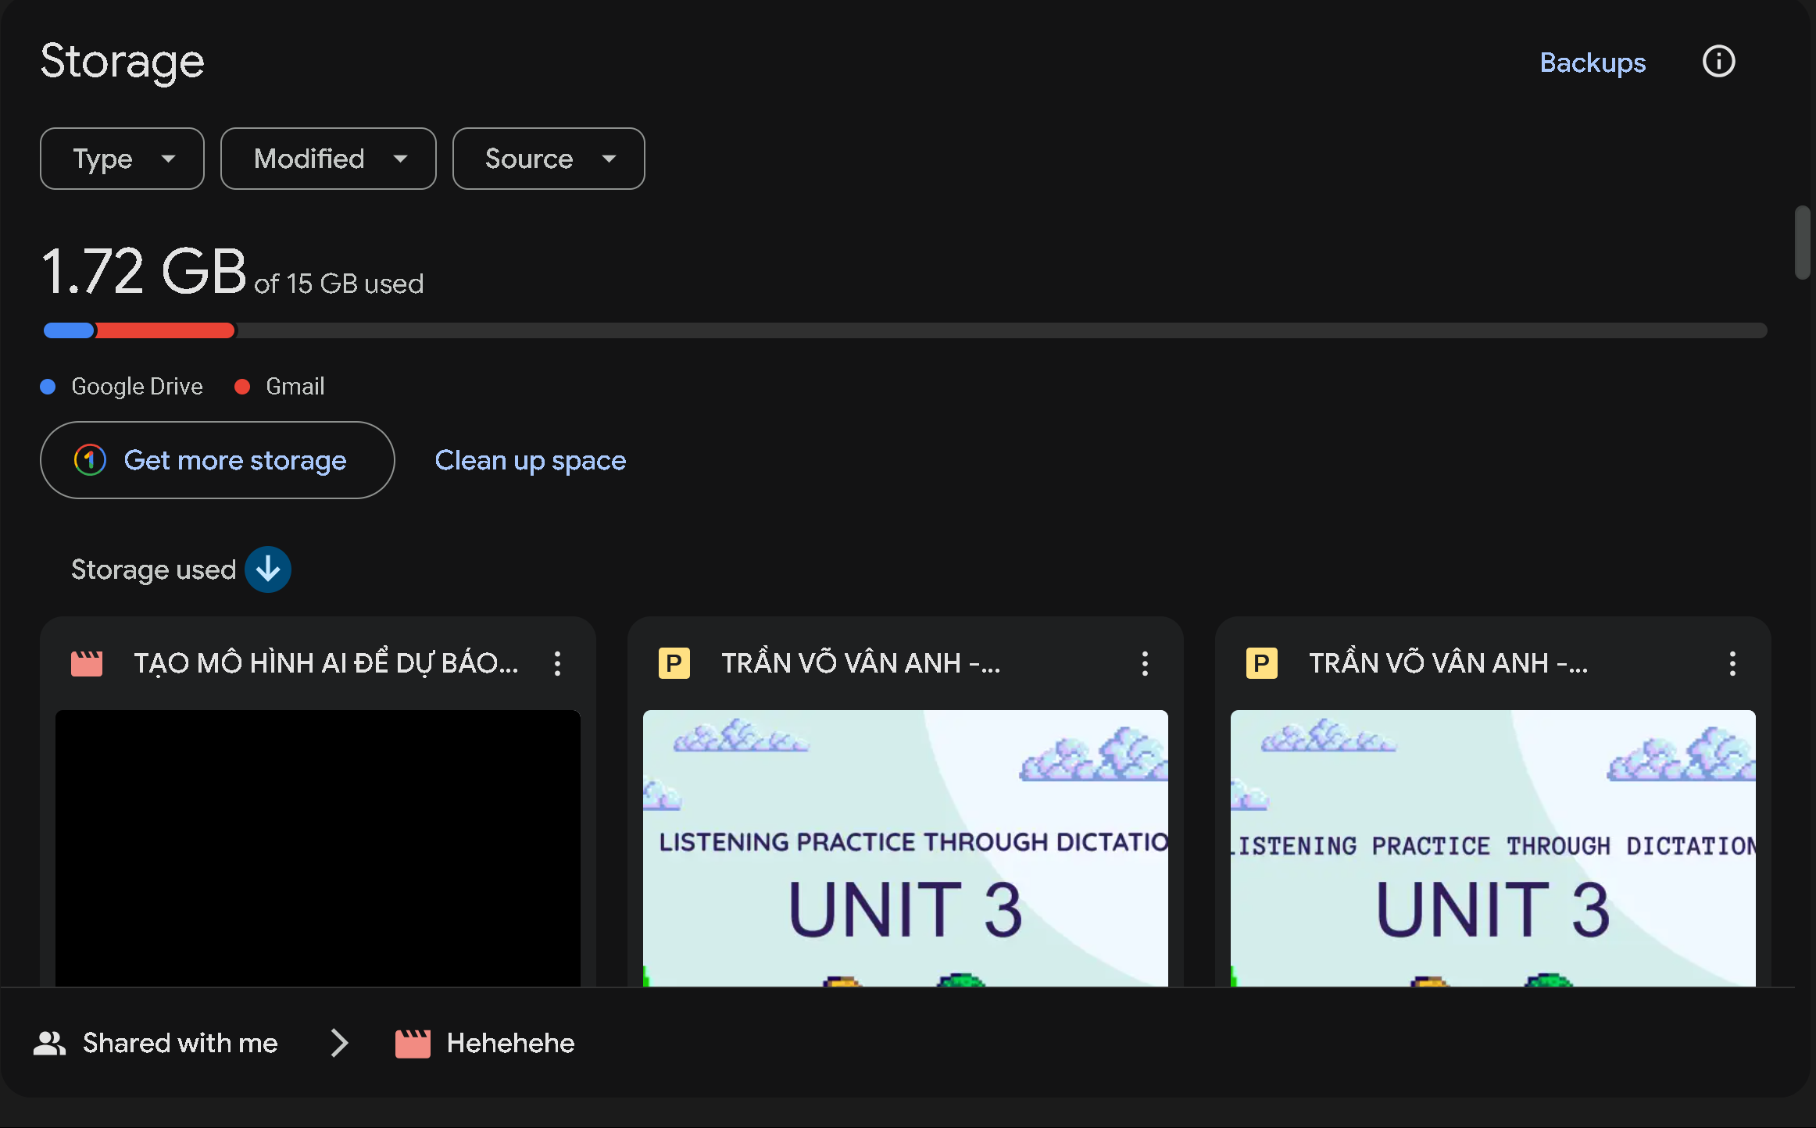
Get storage
Get list file by size
Notes:
--get storage information of an user
select
u.Capacity,
u.UsedCapacity,
u.Capacity - u.UsedCapacity as RemainingCapacity
from Users u
where u.Id = 1
order by RemainingCapacity DESC;
select
f.Name as FileName,
f.Size
from Files f
join Users u on f.OwnerId = u.Id
where u.id = 1
order by f.Size DESC;

Slide 18
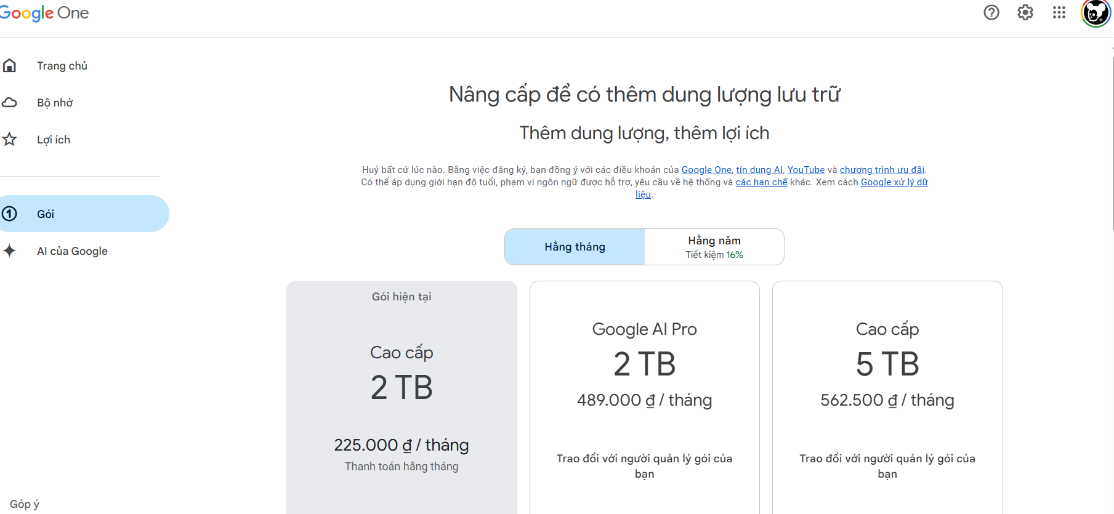
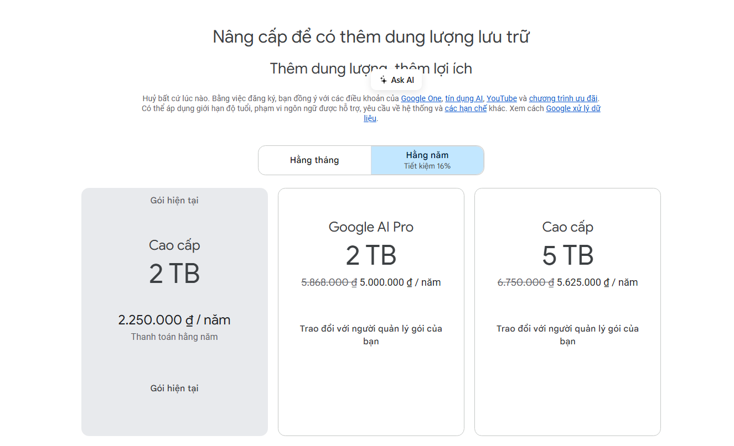
Product UI
Duration
Product
Promotion

Slide 19
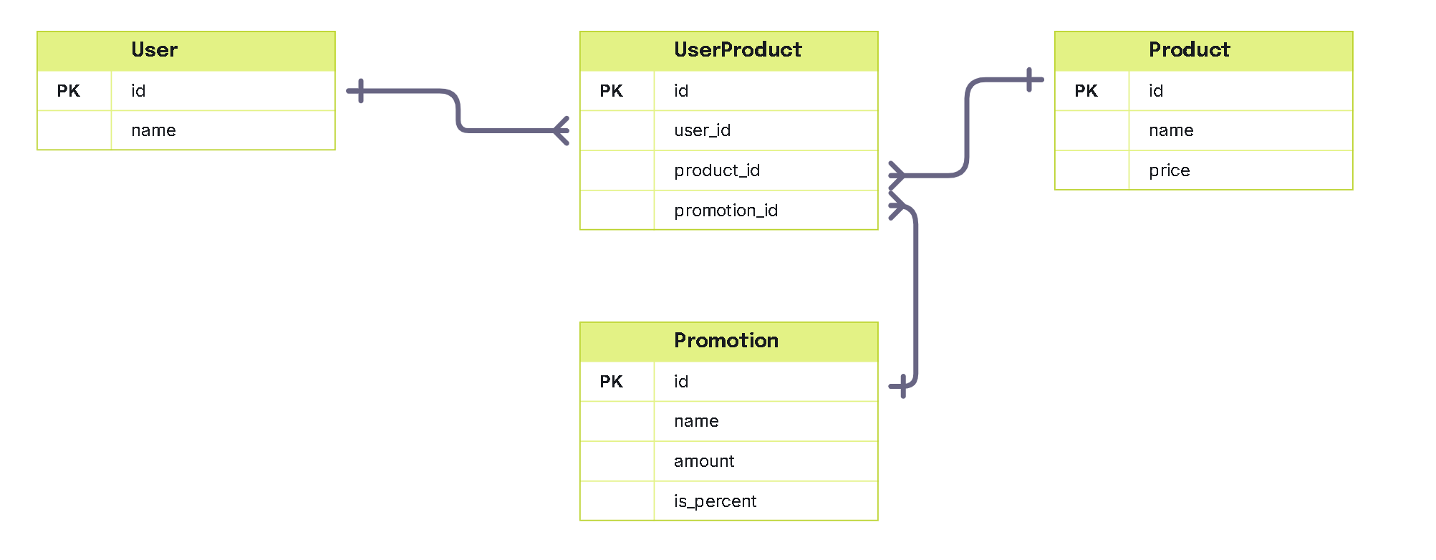
Table for Product Feature

Slide 20
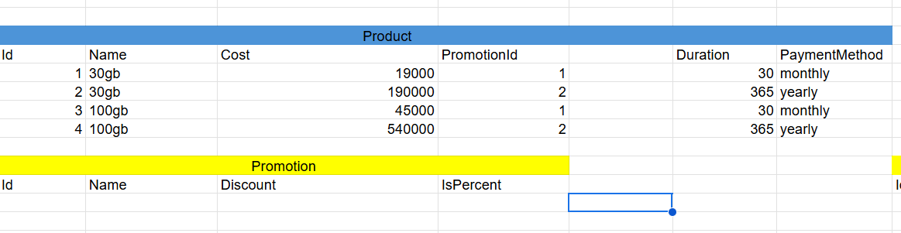
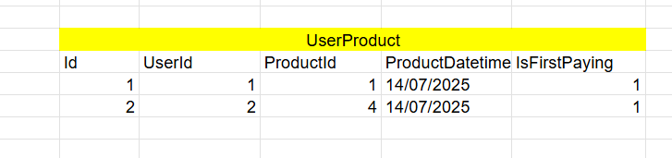

Slide 21
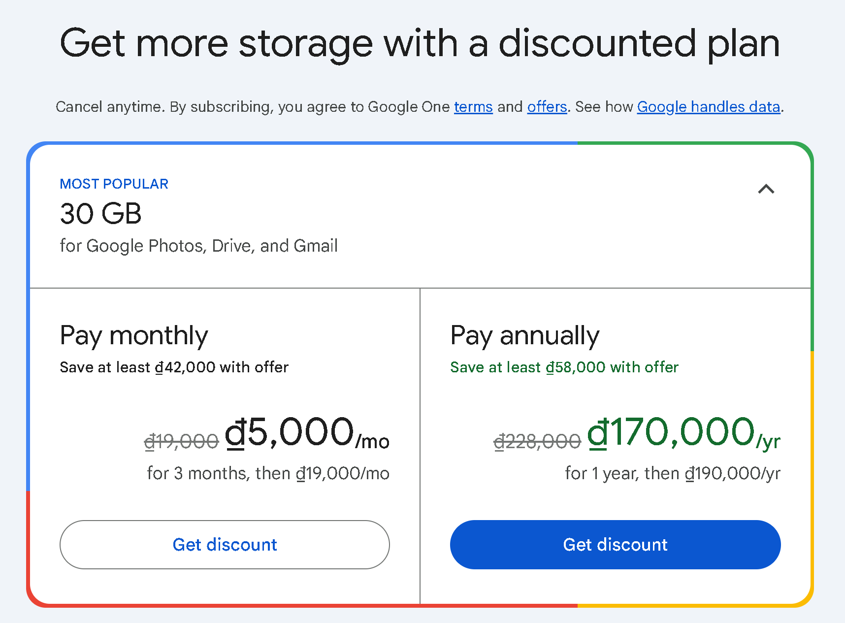
Get product bought by a user
Get products can be bought by an user
Notes:
select
p.Id,
p.Name as ProductName,
u.Name as UserName,
up.PayingDatetime,
up.EndDatetime,
pr.Name as PromotionName
from UserProduct up
join Products p on up.ProductId = p.Id
join Users u on up.UserId = u.Id
join Promotion pr on up.PromotionId = pr.Id
where u.Id = 199

Slide 22
Resolve permission problem
in
Google Drive

Slide 23
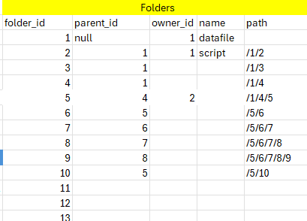
Add column path to table folder
To know what is childrent folder

Slide 24
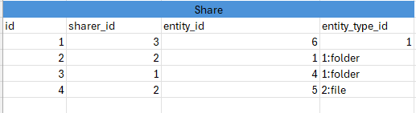
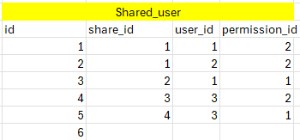
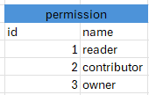

Slide 25
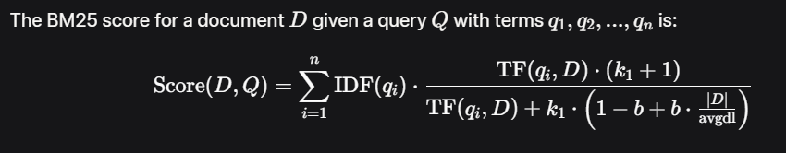
WHAT IS BM25 ?
How to score in BM25 ?

Slide 26
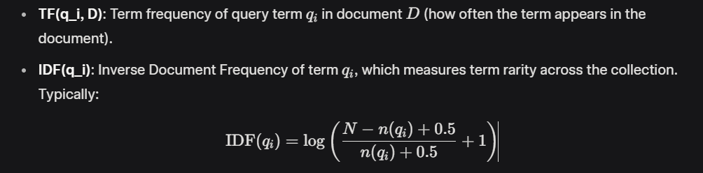
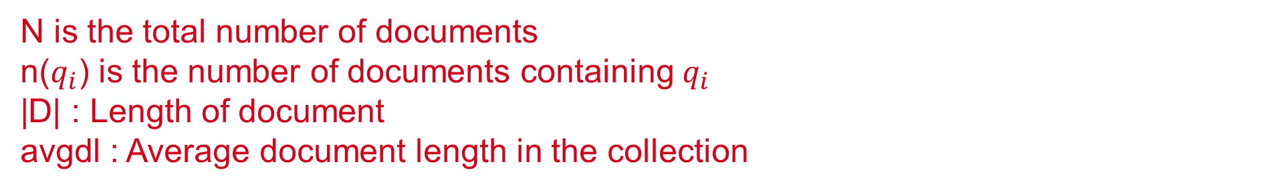
n(qi) is the number of documents containing qi a.k.a df
|D| : Length of document
avgdl : Average document length in the collection

Slide 27
k_1: A parameter (typically 1.2 to 2.0) controlling the impact of term frequency. Higher values allow more influence from frequent terms.
b: A parameter (typically 0.75) controlling the effect of document length normalization. b=0 disables length normalization, while fully normalizes by document length.

Slide 28
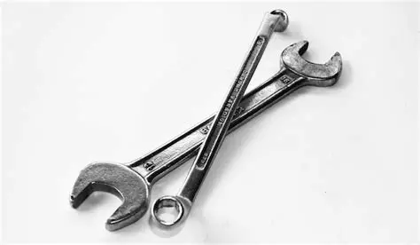
HOW IT WORKS ?

Slide 29
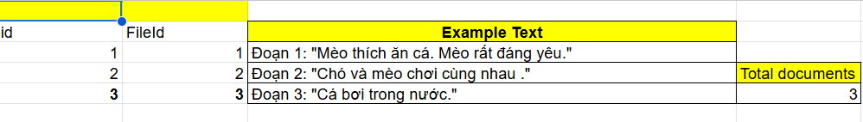
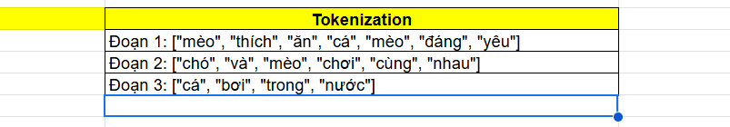

Slide 30
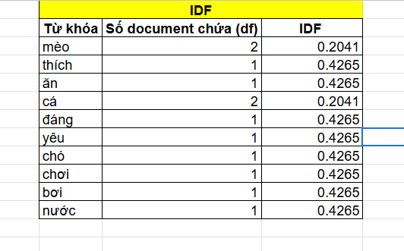

Caculate IDF ( InverseIndexFrequency)
N=3
n(qi)=df(documentfrequency)

Slide 31
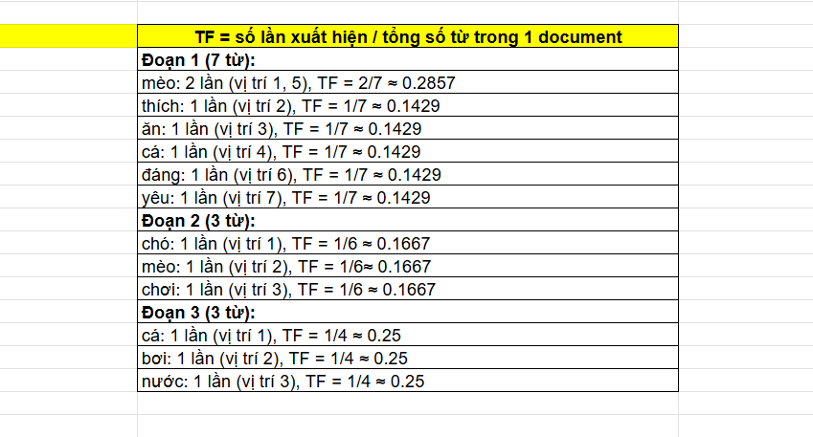
TF (TermFrequency)
Tf = ApperanceCount / |D|

Slide 32
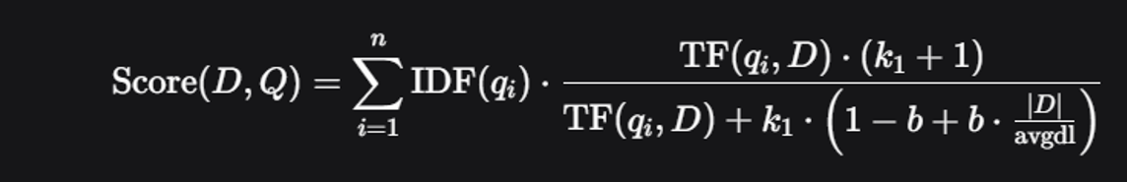
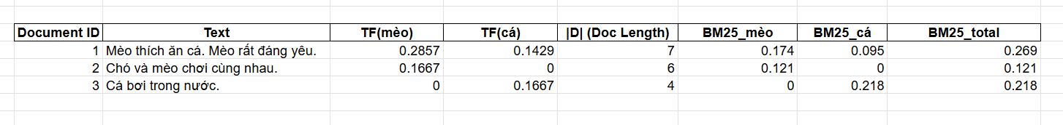
Total Score
k1=1.2
b=0.75
avgdl=5.67

Slide 33
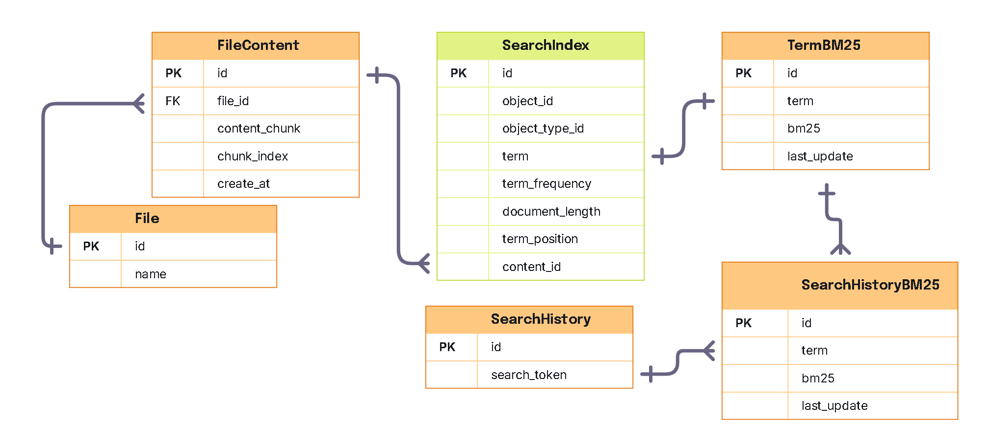
SQL Implement Full Text Search BM25

